Slide 1
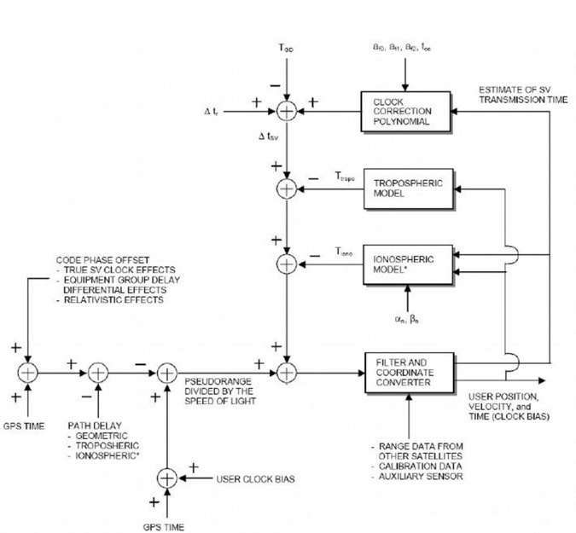
11th Annual Baška GNSS Conference Baška, Krk Island, Croatia 7 – 9 May, 2017
Improvement of standard GPS position estimation algorithm through utilisation of Weighted Least-Square approach
Mia Filić, Luka Grubišić
Faculty of Science, University of Zagreb, Croatia
Notes:
1

Slide 2
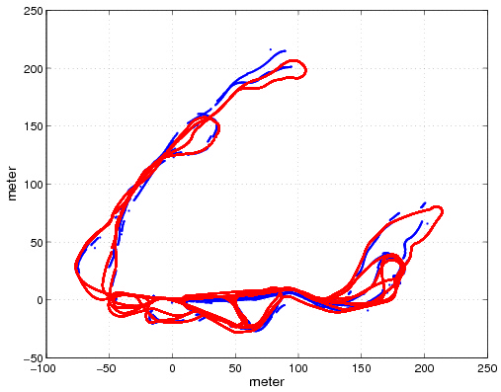
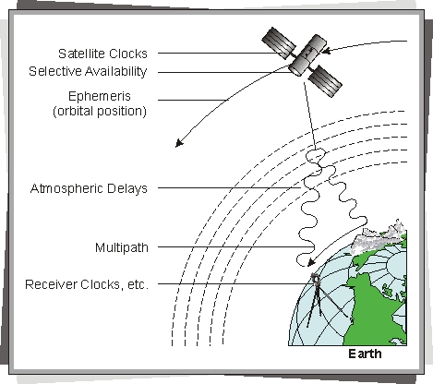
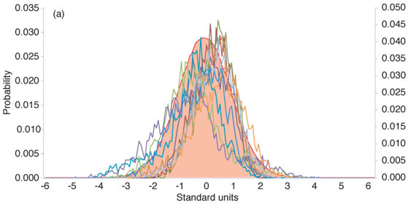
11th Annual Baška GNSS Conference Improvement of GPS standard position algorithm through WLS approach Mia Filić, Luka Grubišić, Faculty of Science, University of Zagreb, Croatia
Content of the presentation
Introduction
Problem description
WLSA-improved GPS position estimation
Concept validation
Discussion
Conclusion
Reference
Notes:
2

Slide 3
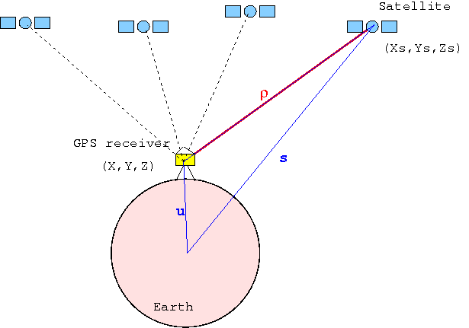
11th Annual Baška GNSS Conference Improvement of GPS standard position algorithm through WLS approach Mia Filić, Luka Grubišić, Faculty of Science, University of Zagreb, Croatia
Introduction
GPS position process is based on measurements -> imperfect position estimates corrupted with the effects of error sources
Notes:
3

Slide 4
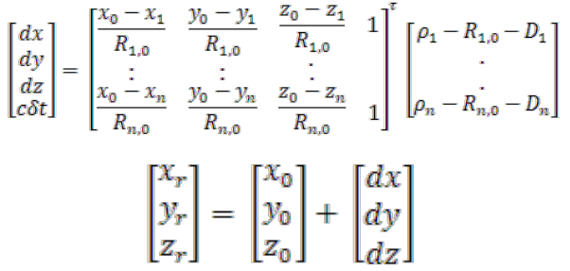
11th Annual Baška GNSS Conference Improvement of GPS standard position algorithm through WLS approach Mia Filić, Luka Grubišić, Faculty of Science, University of Zagreb, Croatia
Problem description
Single-frequency code-based single-point GPS position estimation
All the errors compensated y = G x | Un-compensated errors remain Y = G X + ε
 | ?
Notes:
4

Slide 5
11th Annual Baška GNSS Conference Improvement of GPS standard position algorithm through WLS approach Mia Filić, Luka Grubišić, Faculty of Science, University of Zagreb, Croatia
Problem description
Single-frequency code-based single-point GPS position estimation
Notes:
5

Slide 6
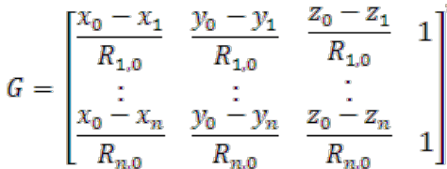
11th Annual Baška GNSS Conference Improvement of GPS standard position algorithm through WLS approach Mia Filić, Luka Grubišić, Faculty of Science, University of Zagreb, Croatia
WLSA-improved GPS position estimation
Single-frequency code-based single-point GPS position estimation
All the errors compensated y = G x | Un-compensated errors remain Y = G X + ε
 | Weighted Least-Square Solution Optimisation: min║y - ^y║²_{W} x^_{W} = (G^{T}WG) ⁻¹ G^{T} W y W – diagonal matrix with the elements related to satellite’s azimuth
Notes:
6

Slide 7
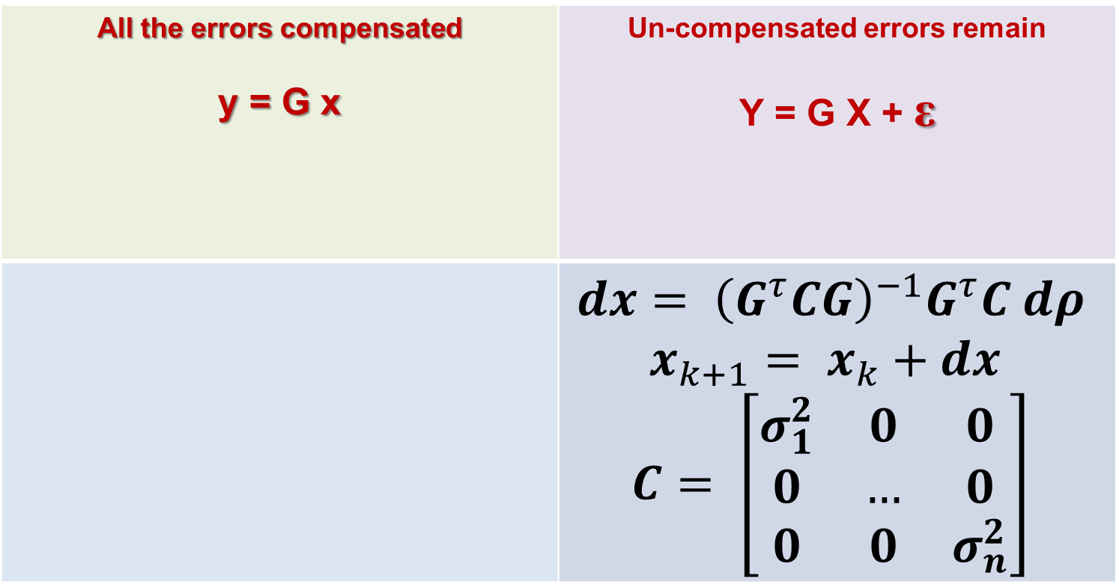
11th Annual Baška GNSS Conference Improvement of GPS standard position algorithm through WLS approach Mia Filić, Luka Grubišić, Faculty of Science, University of Zagreb, Croatia
Problem description
Single-frequency code-based single-point GPS position estimation
All the errors compensated y = G x | Un-compensated errors remain Y = G X + ε
 | $$dx= {\left(G^{τ}CG\right)}^{−1}G^{τ}C dρ$$ $$x_{k+1}= x_{k}+dx$$ $$C= \left[\begin{matrix}σ_{1}^{2} & 0 & 0 \\ 0 & … & 0 \\ 0 & 0 & σ_{n}^{2}\end{matrix}\right]$$
Notes:
7

Slide 8
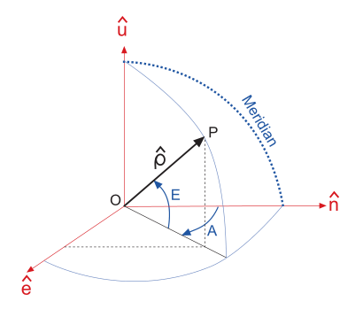
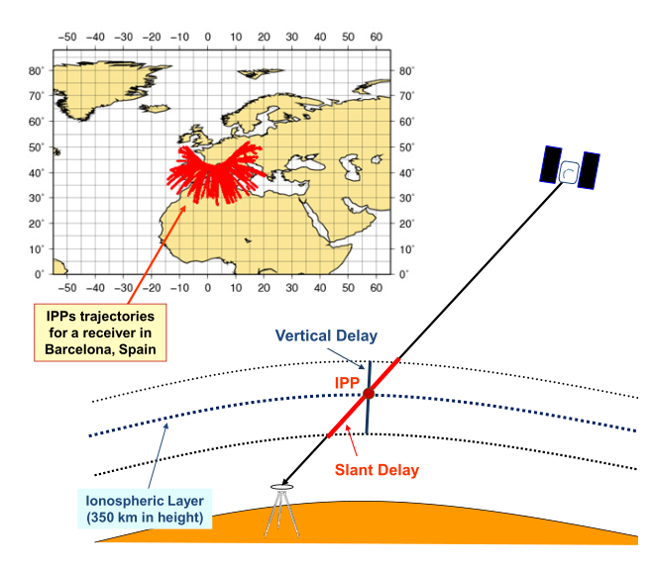

11th Annual Baška GNSS Conference Improvement of GPS standard position algorithm through WLS approach Mia Filić, Luka Grubišić, Faculty of Science, University of Zagreb, Croatia
WLSA-improved GPS position estimation
Single-frequency code-based single-point GPS position estimation
Weights related to satellite ray elevation angle
$$σ_{n}^{2}= \frac{1}{\sin^{2}\left(\frac{π}{2}−E_{n}\right)}$$
Notes:
8

Slide 9
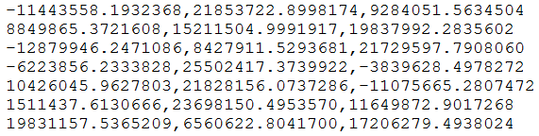
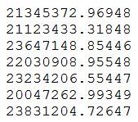
11th Annual Baška GNSS Conference Improvement of GPS standard position algorithm through WLS approach Mia Filić, Luka Grubišić, Faculty of Science, University of Zagreb, Croatia
Concept validation
Simulation-based approach with real GPS observations processed with R-based software
Non-WLSA (standard approach, assuming all errors are compensated, or do nothing with the errors)
WLSA (Weghted Least-Square Adjustment)
Notes:
9

Slide 10
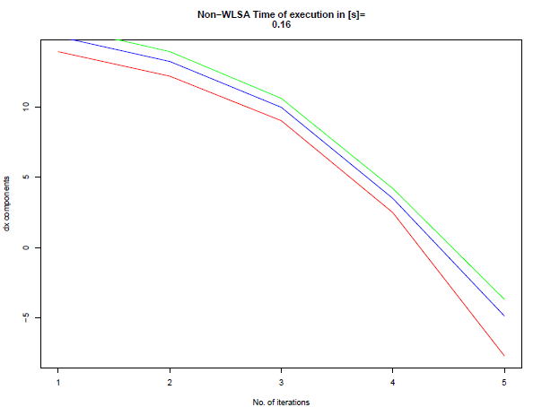
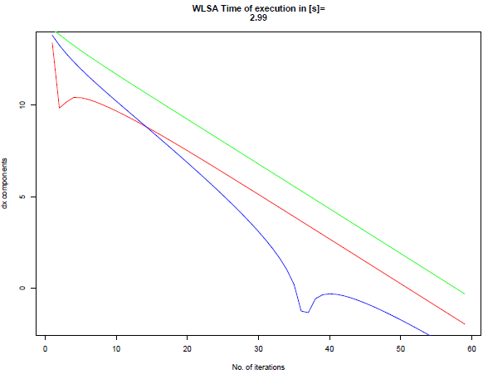
11th Annual Baška GNSS Conference Improvement of GPS standard position algorithm through WLS approach Mia Filić, Luka Grubišić, Faculty of Science, University of Zagreb, Croatia
Concept validation results
Red -> dx, Green -> dy, Blue -> dz
Notes:
10

Slide 11
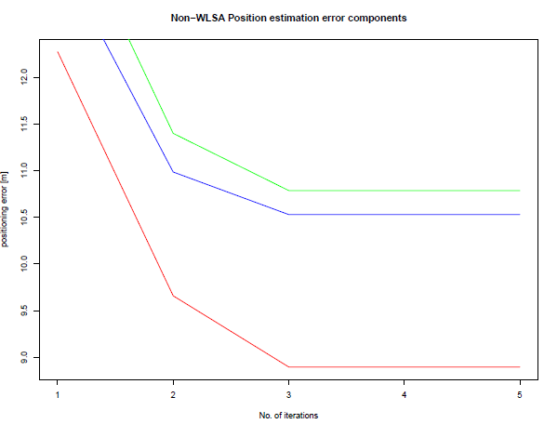
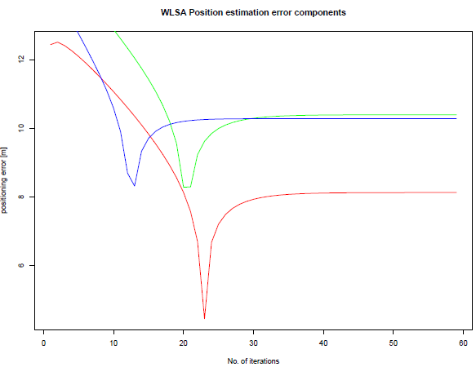
11th Annual Baška GNSS Conference Improvement of GPS standard position algorithm through WLS approach Mia Filić, Luka Grubišić, Faculty of Science, University of Zagreb, Croatia
Concept validation results
Red -> x, Green -> y, Blue -> z
Notes:
11

Slide 12
11th Annual Baška GNSS Conference Improvement of GPS standard position algorithm through WLS approach Mia Filić, Luka Grubišić, Faculty of Science, University of Zagreb, Croatia
Discussion
WLSA introduced, based on relation to satellite ray elevation angle
Non-WLSA-based algorithm (traditional): fast iteration convergence, worse positioning quality with un-compensated pseudoranges
WLSA-based algorithm: slower iteration convergence, improved positioning quality with un-compensated pseudoranges
Challenges of R implementation: inverse matrix calculation (performed through deplyoment of Choleski matrix decomposition method)
Notes:
12

Slide 13
11th Annual Baška GNSS Conference Improvement of GPS standard position algorithm through WLS approach Mia Filić, Luka Grubišić, Faculty of Science, University of Zagreb, Croatia
Conclusion
Navigation/position estimation algorithms (traditional non-WLSA vs WLSA based on satellite ray elevation angle) comparison with software deployment in R framework for statistical computing
Non-WLSA faster, but of lower quality of position estmation based on un-compensated or partially compensated pseudoranges
WLSA slower, but improved quality of position estmation based on un-compensated or partially compensated pseudoranges
Future research: different weights, utilisation of neural networks for taming stochastic non-Gaussian GPS position estimation errors
Notes:
13

Slide 14
11th Annual Baška GNSS Conference Improvement of GPS standard position algorithm through WLS approach Mia Filić, Luka Grubišić, Faculty of Science, University of Zagreb, Croatia
Reference
[1] Gustafsson, F. (2010). Statistical Sensor Fusion. Studentlitteratur. Linkoeping University. Linkoeping, Sweden.
[2] Sanz Subirana, J et al. (2013). GNSS Data Processing – Vol. I: Fundamentals and Algorithms. European Space Agency (ESA). Nordwijk, The Netherlands. Available at: http://bit.ly/1QV4KAL, accessed on 5 February, 2017.
[3] Farrell, J A. (2009). Aided Navigation: GPS with High Rate Sensors. McGraw-Hill. New York, NY.
[4] Fornberg, B, and Herbst, B. (2010). Modelling in Applied Mathematics. Stellenbosch University. Matieland, South Africa. Available at: http://bit.ly/2pQVpSj, accessed on 10 April, 2017.
[5] Tian, A et al. (2013). GPS Single Point Positioning Algorithm Based on Least Sqauers. Proc of sixth International Symposium on Computational Intelligence and Design. Hangzhou, China.
[6] Nielsen, A A. (2013). Least Squares Adjustment: Linear and Nonlinear Weighted Regression Analysis (technical note). Technical University of Denmark. Lyngby, Denmark.
[7] Rahman, M Z. Beyond Trilateration: GPS Positioning Geometry and Analytical Accuracy. Chapter 10 in: Jin, S. (2012). Global Navigation Satellite Systems – Signals, Theory and Applications. Intechopen. Rijeka, Croatia.
[8] Rahemi, N et al. (2014). Accurate Solution of Navigation Equiations in GPS Receivers for Very High Velocities Using Pseudorange Measurements. Adv in Aerospace Engineering, 2014, Article ID 435891, 8 pages. Doi.org/10.1155/2014/435891. Available at: http://bit.ly/2oNr7QN
Notes:
14

Slide 15

THANK YOU FOR YOUR ATTENTION !
Mia Filić, MRIN,
Department for Mathematics,
Faculty of Science,
University of Zagreb, Croatia
E-mail: filicmia@gmail.com

